Slide 1

PYKLA MEETUP
Topic: Building executables using eel
Date: March 27th , 2019
Time: 6:00pm “African Time”
Venue: Here
Presenter: Douglas

Slide 2
About the presenter
Douglas Ssekuwanda
Bachelors in Statistics (2018)
Skills; Electronics, Arduino, Rasberry pi, Python(Django, Pandas), machine learning, Baking, Javascript, Designer
Website: dougwandas.com
Email:douglasekuwanda@gmail.com
Projects: schoolifyx, moviefimbooo etc

Slide 3
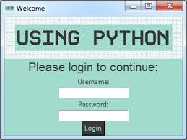
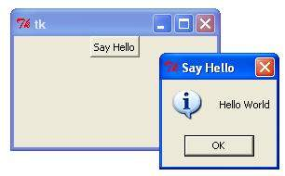
History of python GUIs
Tkinter:- De-facto standard GUI package
PyQt:- From the Qt bindings
PySide:- Child of PyQt
Kivy:- Cross plate form gui creator
WxPython:- A blending of the WxWidgets C++ class lib
EEL:- A lib for making Electron like offline Html/JS GUIs
Others: urwid, Toga, pywebview, pyglet, Gooey, enaml, Flexx, pysimpleGUI

Slide 4
Welcome to eel
Eel – a simple Electron-like lib used for making offline HTML/JS GUI apps, with full access to python capabilities and libraries like pandas, requests, beautifulsoup, sqlite, sockets,
Started by chris knott around a year ago and it is actively maintained.
Github stars ~2600
https://github.com/ChrisKnott/Eel
https://nitratine.net/blog/post/python-gui-using-chrome/

